Slide 1
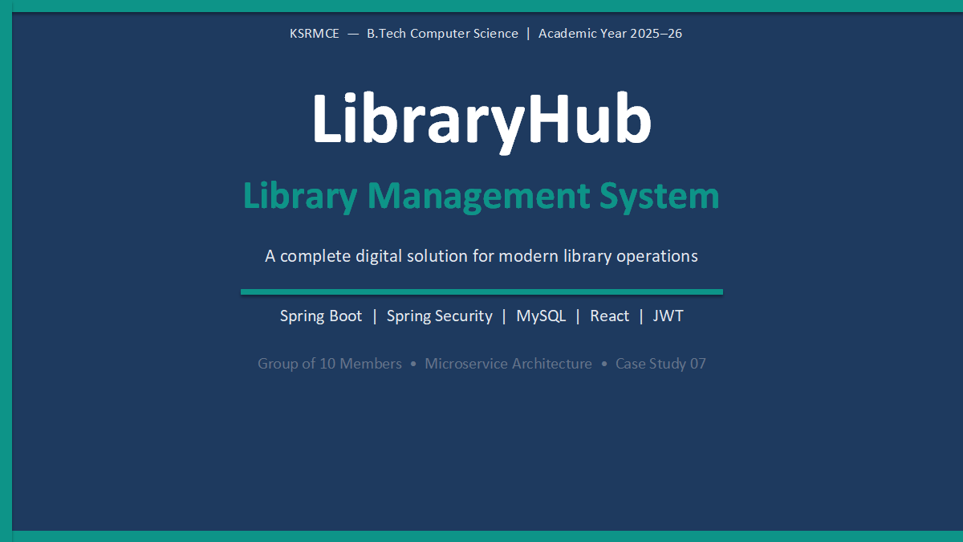

Slide 2
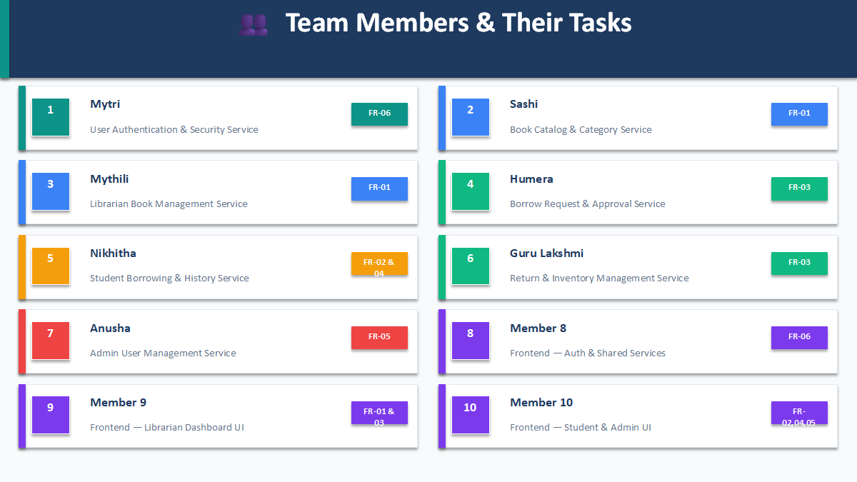

Slide 3
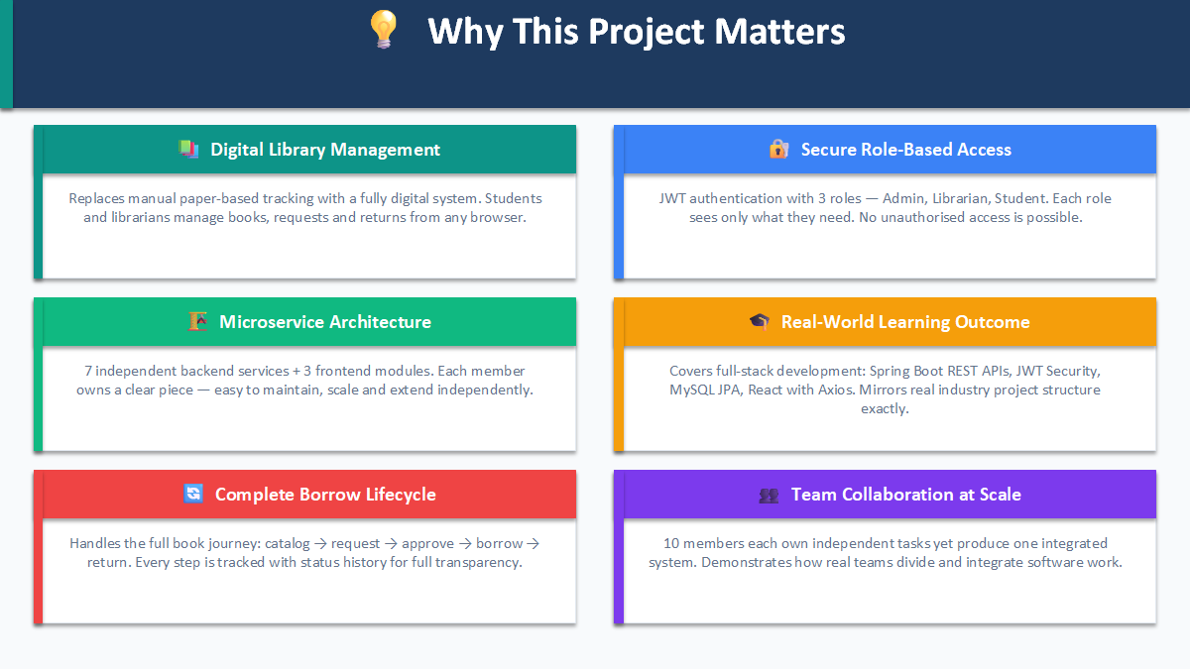

Slide 4
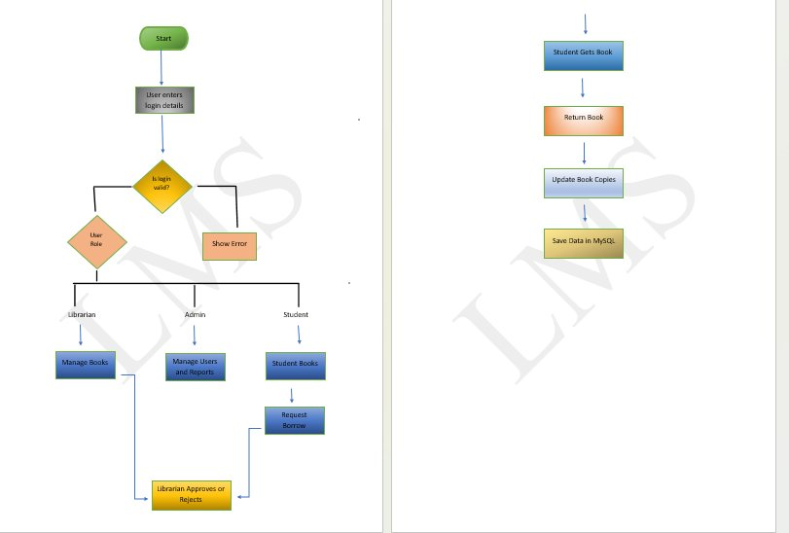
System Flowchart — LMS Flow ChartProcess
LibraryHub · Member 6 — Return & Inventory Management Service

Slide 5
User
👤
Authentication
🔒
& Security Service
Member1 E M B E R 1
LibraryHub — Case Study 01
Spring Boot · Spring Security · MySQL · JWT
Microservice Assignment
Group of 10 Members
FR-06 · User.java · All Roles: ADMIN / LIBRARIAN / STUDENT

Slide 6
Service Overview
Member 1 owns the Security Foundation — the backend service that handles registration, login, and JWT-based authentication for all three roles. Every other microservice depends on the JWT token and role guards produced by this service.
👥
🔑
🛡️
Registration
Login & JWT Token
Role-Based Security
Registers ADMIN, LIBRARIAN, and STUDENT users with BCrypt encrypted passwords stored in MySQL.
Authenticates users and issues a signed JWT token containing the user's role and userId.
Secures all endpoints using Spring Security — only the correct role can access each route.
LibraryHub · Member 1 — User Authentication & Security Service

Slide 7
Functional Requirement
FR-06 — User Authentication & Security
FR
1. The system shall allow any role (ADMIN / LIBRARIAN / STUDENT) to register with a unique email and password.
06
2. The system shall authenticate users by email and password and issue a signed JWT session token.
3. The system shall embed the user's role and userId inside the JWT token payload.
Security &
Authentication
4. All librarian, student, and admin routes shall be secured using Spring Security role guards.
Core File:
User.java
Entity with id, username, password, email, role — shared across all members
LibraryHub · Member 1 — User Authentication & Security Service

Slide 8
REST API Endpoints
/api/auth/register
Public
POST
Registers a new user. Accepts name, email, password, and role (ADMIN / LIBRARIAN / STUDENT). Password is BCrypt-hashed before saving.
/api/auth/login
Public
POST
Authenticates the user by email and password. Returns a signed JWT token containing role and userId for use in all subsequent API calls.
/api/auth/logout
Auth Required
POST
Logs out the user. Frontend clears the JWT token from localStorage. All protected endpoints become inaccessible until next login.
Register and Login are open to all. All other endpoints require a valid JWT Bearer token in the Authorization header.
LibraryHub · Member 1 — User Authentication & Security Service

Slide 9
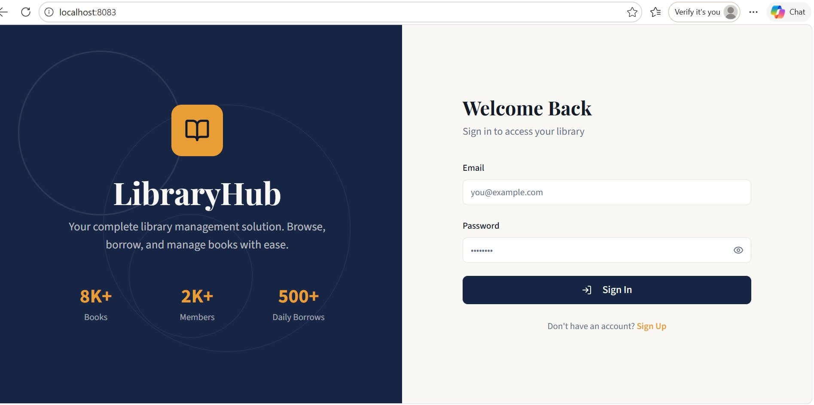
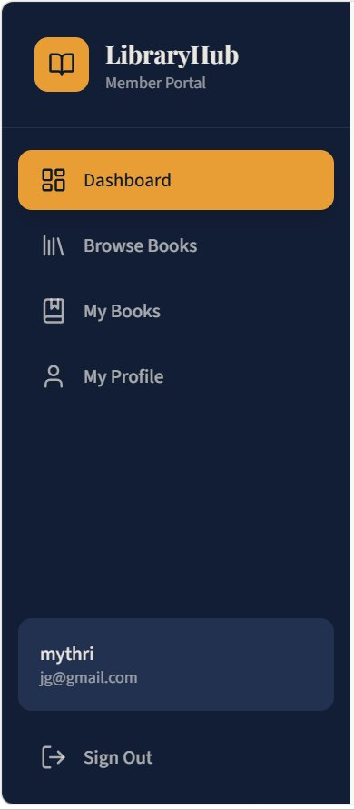
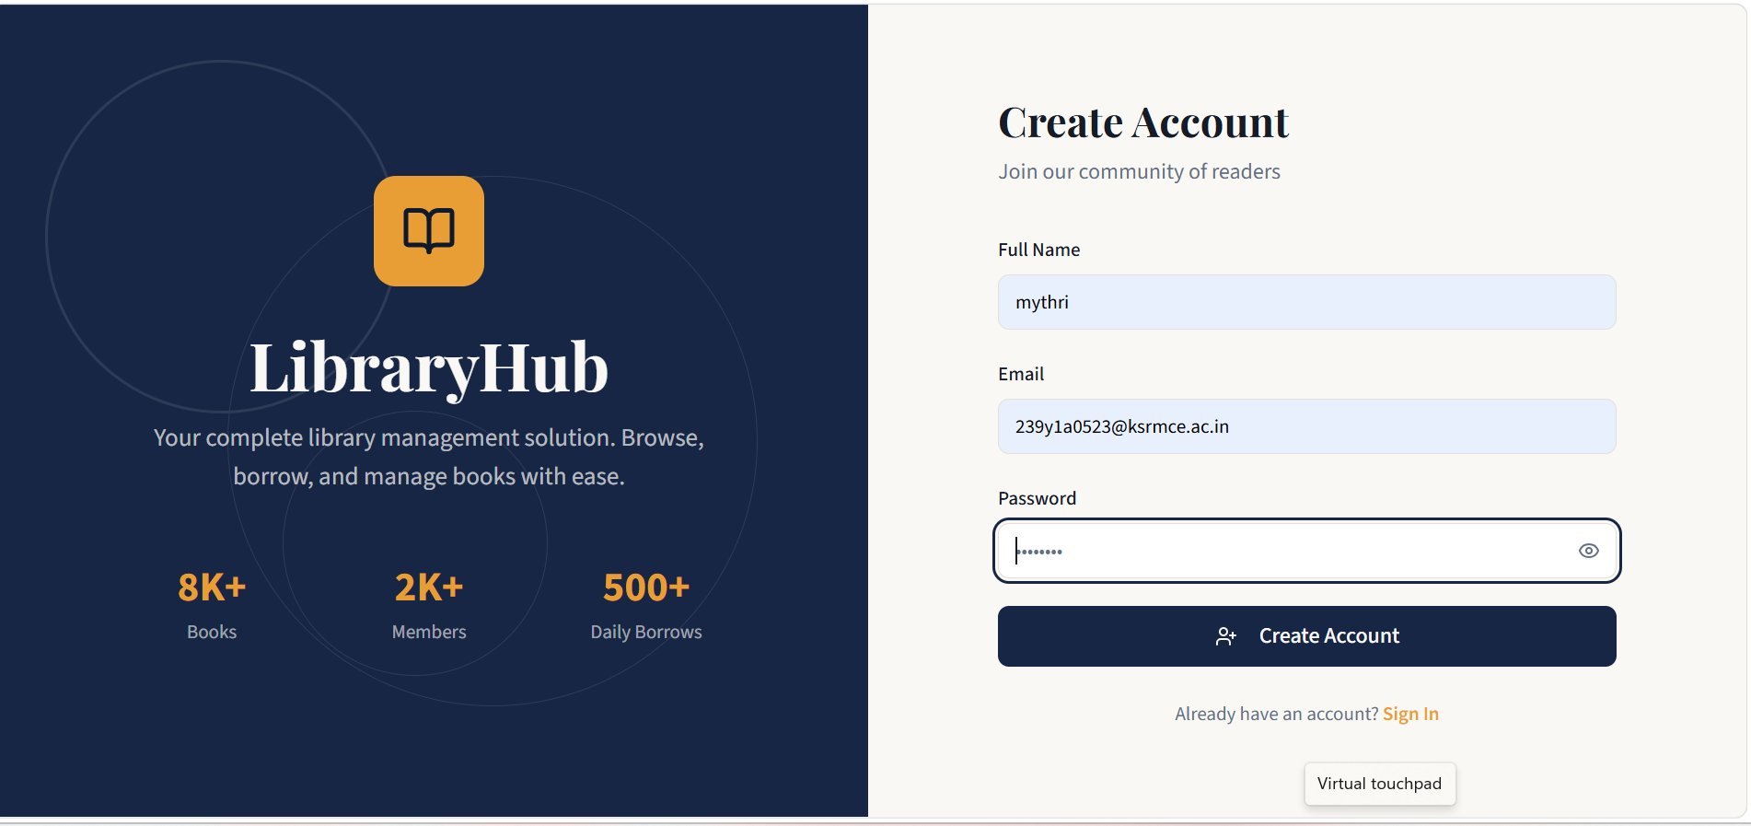
Frontend Output — Live Screenshots
React · localhost:8083
1
Login Page — Welcome Back (localhost:8083)
2
Student Dashboard — After Login
3
Register Page — Create Account
✅ Login Working
✅ JWT Token Issued
✅ Role Redirect Working
✅ Register Working
LibraryHub · Member 1 — Frontend Output · React · localhost:8083

Slide 10
Directory Structure
auth-service / src / main / java / com / libraryhub_auth_service
Key Files
libraryhub_auth_service/
src/main/java/com/libraryhub_auth_service/
LibraryhubAuthServiceApplication.java
+-- LibraryhubAuthServiceApplication.java
Spring Boot entry point for the auth microservice
+-- controller/
| AuthController.java
AuthController.java
+-- dto/
Defines POST /register, POST /login, POST /logout
| LoginRequest.java RegisterRequest.java
+-- entity/
AuthService.java
| User.java
+-- repository/
Business logic: registration, login, JWT generation
| UserRepository.java
+-- security/
JwtUtil.java
| JwtUtil.java JwtFilter.java SecurityConfig.java
Generates and validates JWT tokens with role + userId
+-- service/
| AuthService.java
SecurityConfig.java
+-- resources/ application.properties
Spring Security config, CORS, JWT filter chain
application.properties
DB connection, server port 8080, JWT secret key
LibraryHub · Member 1 — User Authentication & Security Service

Slide 11
Deliverables
1
</>
User.java
Entity — id, username, password, email, role (ADMIN / LIBRARIAN / STUDENT)
2
📝
POST /api/auth/register
Register any user role — saves BCrypt-hashed password to MySQL users table
3
🔑
POST /api/auth/login
Login and return JWT session token containing role and userId in payload
4
⚙️
Spring Security + JWT Filter
JwtFilter validates every request; SecurityConfig sets up the filter chain
5
🛡️
Role-Based Access Control
All librarian, student, and admin routes secured via @PreAuthorize role guards
LibraryHub · Member 1 — User Authentication & Security Service

Slide 12
📚 Member 22
Book Catalog & Category Service
Spring Boot | MySQL | React (TypeScript)
FR-01
Backend
Book Entity Owner
LibraryHub — Library Management System • Group of 10

Slide 13
How Other Members Connect to Member 2
Member 3
Librarian CRUD
Member 5
Student Borrow
Uses: addBook()
updateBook()
deleteBook()
Uses: getAllBooks()
searchBooks()
isAvailable()
Member 9
Librarian UI
Member 10
Student UI
Calls: GET /books
POST /books
DELETE /books
👤 Member 2
Book Catalog Service
Calls: GET /books
search?query=
Member 4
Borrow Approval
Member 6
Return Service
Uses: getBookById()
decrement
AvailableCopies()
Uses: getBookById()
increment
AvailableCopies()

Slide 14
Project File Structure
Book.java
catalog-service/
Core entity. availableCopies managed here.
src/main/java/com/libraryhub/catalog/
CatalogServiceApplication.java
Category.java
OneToMany parent. Holds list of books.
entity/
Book.java
BookRepository.java
Category.java
searchByKeyword(), existsByIsbn(), findByCategoryId()
repository/
CategoryRepository.java
BookRepository.java
findByNameIgnoreCase(), existsByNameIgnoreCase()
CategoryRepository.java
BookService.java
service/
All business logic. addBook(), updateBook() etc.
BookService.java
CatalogController.java
controller/
REST endpoints. @CrossOrigin for frontend.
CatalogController.java
application.properties
resources/application.properties
DB config, port 8080, ddl-auto=update

Slide 15
Postman Testing Guide
1
Add Category
4
Search Books
POST
/api/catalog/categories
GET
/api/catalog/books/search?query=java
Expected: 201 Created
Expected: 200 OK + results
{ "name": "Technology",
"description": "Tech books" }
No body needed
2
Add Book
5
Update Book
POST
/api/catalog/books
PUT
/api/catalog/books/1
Expected: 201 Created
Expected: 200 OK
{ "title": "Java Programming",
"author": "James Gosling",
"totalCopies": 5 }
{ "title": "Updated Title",
"totalCopies": 10 }
3
Get All Books
6
Delete Book
GET
/api/catalog/books
DELETE
/api/catalog/books/1
Expected: 200 OK + list
Expected: 204 No Content
No body needed
No body needed

Slide 16
03
Librarian
MEMBER
Book Management
LibraryHub
Group Project
Service
Full CRUD operations for the LibraryHub book catalog.
Librarian-facing REST API secured with Spring Security.
LibrarianController.java
controller/LibrarianController.java · wired to BookService (M2)
Spring Boot
FR-01
Backend

Slide 17
My Role & Responsibility
02 / 10
⚙ Layer
📋 FR
🌱 Stack
Backend
FR-01
Spring Boot
What I'm Building
Depends On
Build LibrarianController.java — the core CRUD controller
Member 1
Add / Update / Delete / View books via REST endpoints
JWT Auth + Spring Security config
Wire all methods to BookService (provided by Member 2)
Member 2
Lock every endpoint to LIBRARIAN role via Spring Security
Book.java entity + BookService.java
Return proper HTTP status codes on every response
Build Member 1 & 2 before starting your work.

Slide 18
Entity & File Structure
03 / 10
📘 Book.java
⚙ LibrarianController.java
Entity owned by Member 2 · used by your controller
YOUR CORE FILE
id
Long
Primary Key
@RestController
title
String
Book title
@RequestMapping("/api/librarian")
author
String
Author name
@PreAuthorize("LIBRARIAN")
isbn
String
Unique ISBN
@Autowired BookService bookService
genre
String
Book genre
Methods:
totalCopies
int
Total stock
addBook()
updateBook()
availableCopies
int
Available now
deleteBook()
getAllBooks()

Slide 19
REST API Endpoints
04 / 10
POST
/api/librarian/book
🔐 LIBRARIAN
Request Body: Book JSON
→ 201 Created + saved Book
PUT
/api/librarian/book/{bookId}
🔐 LIBRARIAN
@PathVariable: bookId (Long)
→ 200 OK + updated Book
DELETE
/api/librarian/book/{bookId}
🔐 LIBRARIAN
@PathVariable: bookId (Long)
→ 200 OK + success message
GET
/api/librarian/books
🔐 LIBRARIAN
No parameters required
→ 200 OK + List<Book>

Slide 20
Workflow & Method Flow
05 / 10
Librarian
Client
Spring
Security
Librarian
Controller
Book
Service (M2)
MySQL
Database
▶
▶
▶
▶
addBook()
updateBook()
1
POST hits /api/librarian/book
2
@RequestBody → Book object
3
Calls bookService.addBook()
4
Returns Book + HTTP 201
1
PUT with {bookId} in path
2
Finds book or throws 404
3
Calls bookService.updateBook()
4
Returns Book + HTTP 200
→
→
→
→
→
→
deleteBook()
getAllBooks()
1
DELETE with {bookId} in path
2
Finds book or throws 404
3
Calls bookService.deleteBook()
4
Returns message + HTTP 200
1
GET hits /api/librarian/books
2
No input params needed
3
Calls bookService.getAllBooks()
4
Returns List<Book> + HTTP 200
→
→
→
→
→
→

Slide 21
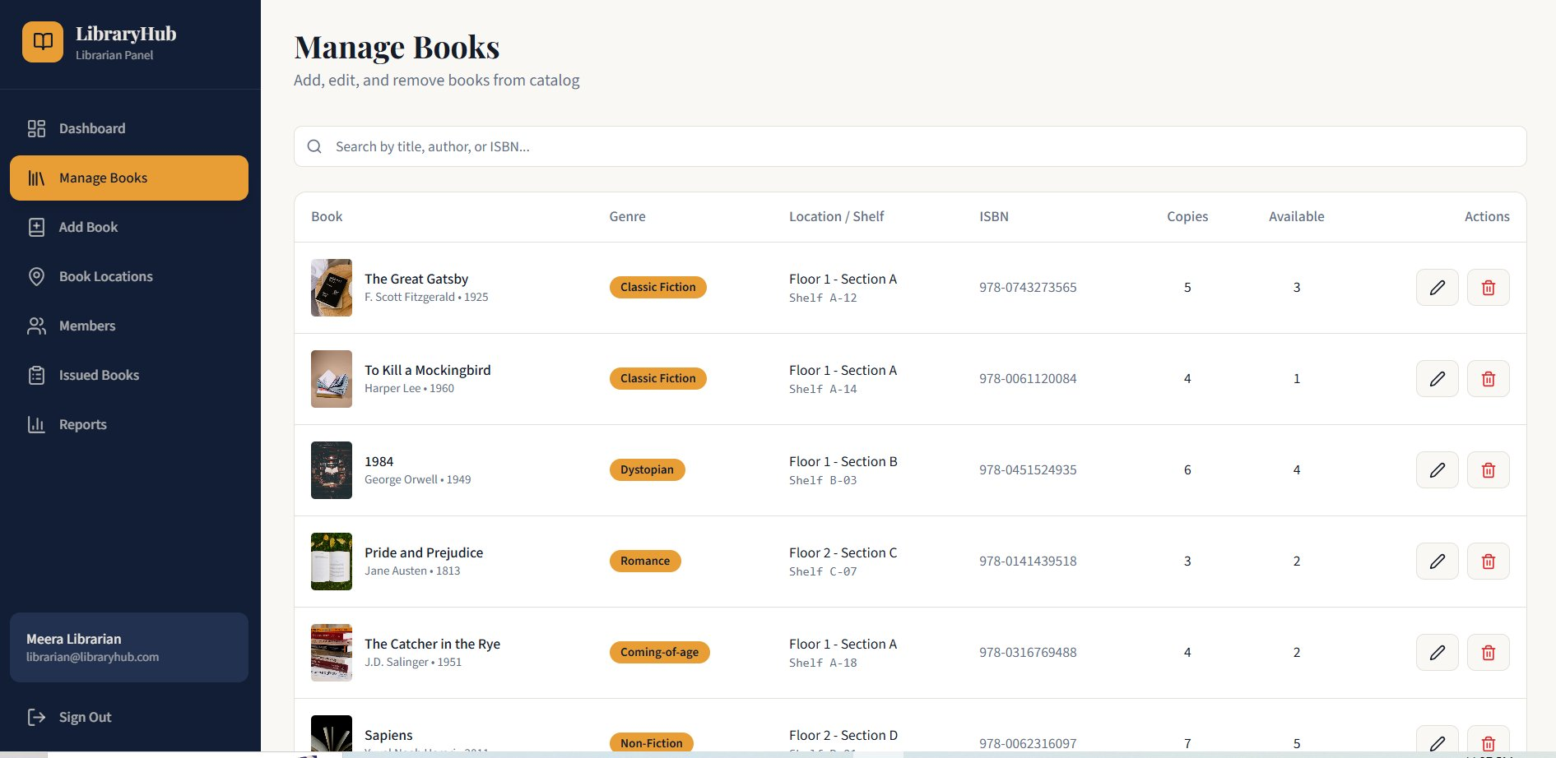
Output 1 — Manage Books (Catalog View)
06 / 10
📚 Full catalog visible
✏ Edit / Delete actions
🔍 Search by title/author/ISBN
📊 Copies & Available count

Slide 22
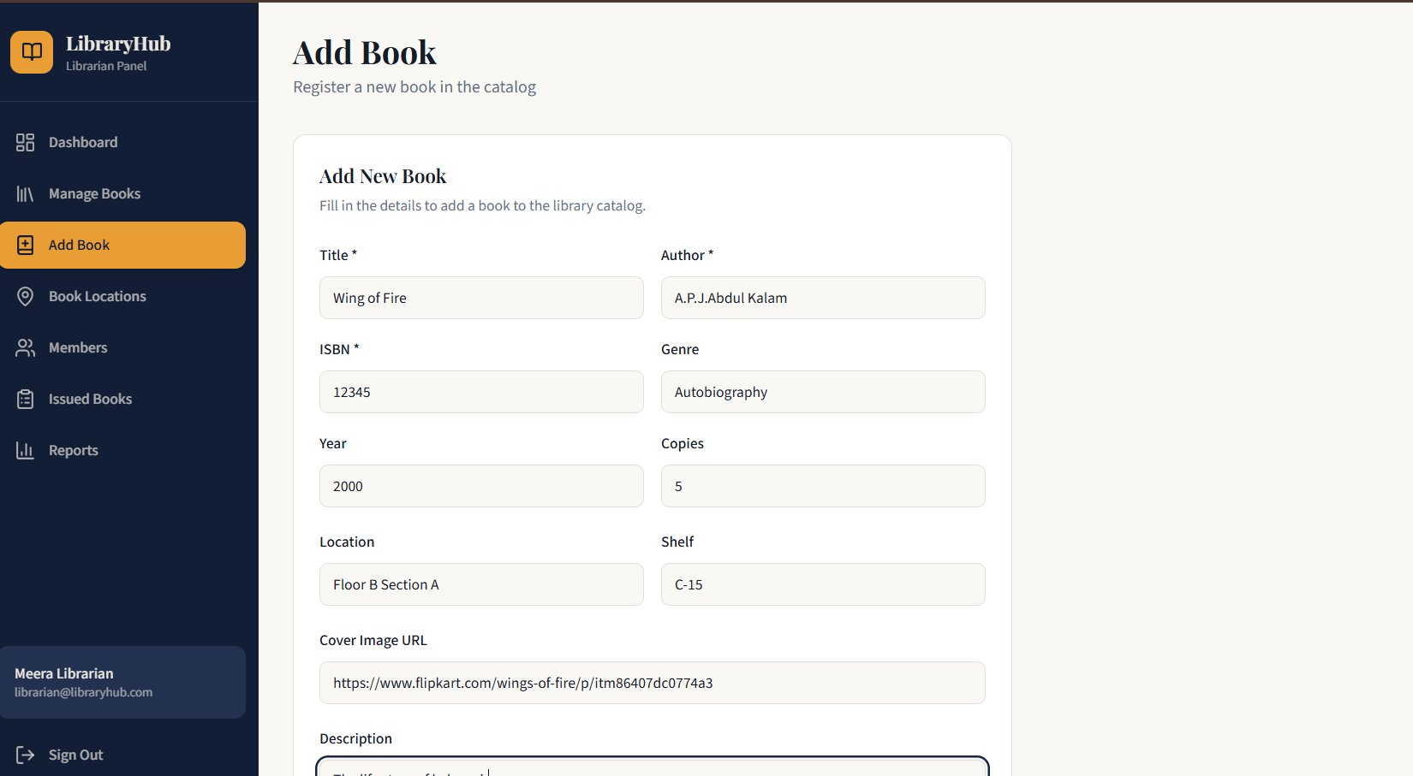
Output 2 — Add Book (POST /api/librarian/book)
07 / 10
📝 Title & Author fields
🔢 ISBN, Genre, Year, Copies
📍 Location & Shelf
🖼 Cover Image URL + Description

Slide 23
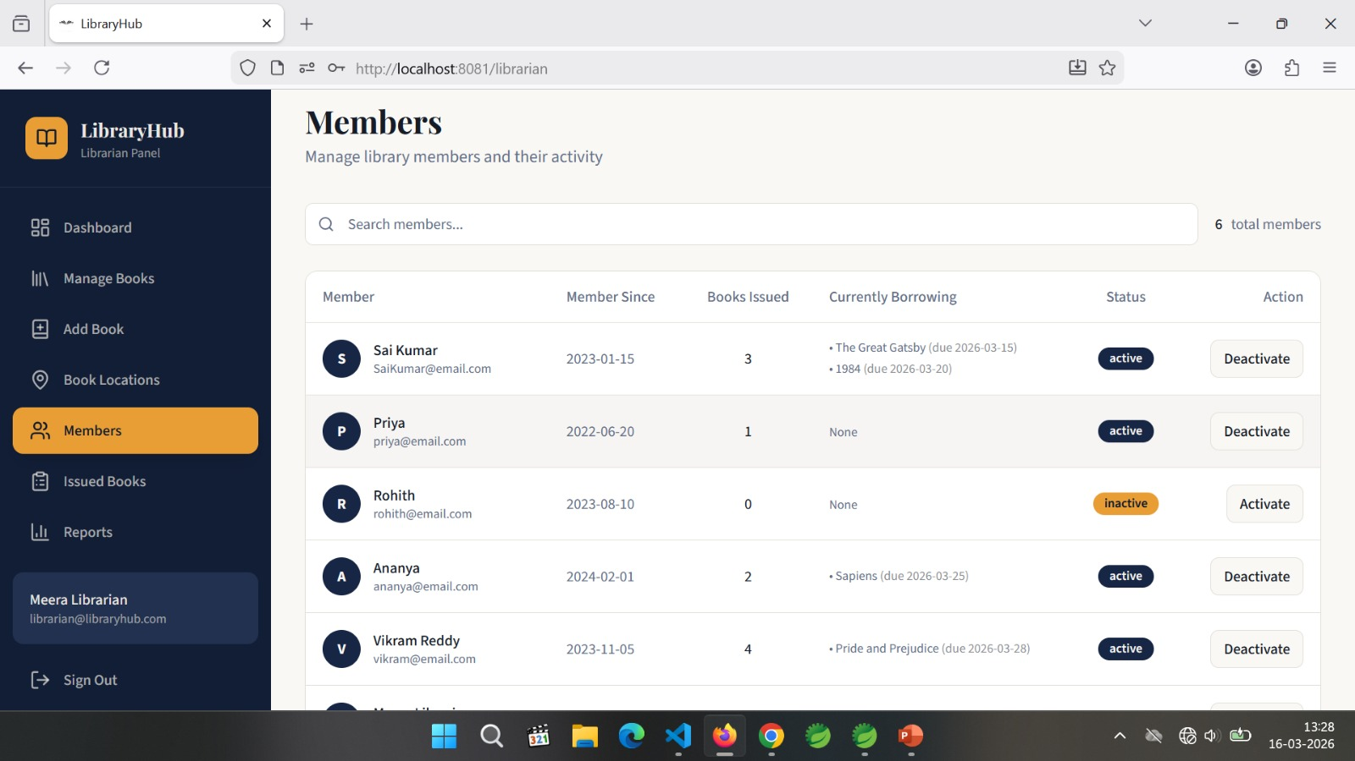
Output 3 — Members (Librarian Panel)
08 / 10
👥 6 total members listed
🟢 Active / Inactive status
📖 Books Issued count
⏰ Currently Borrowing + due dates

Slide 24
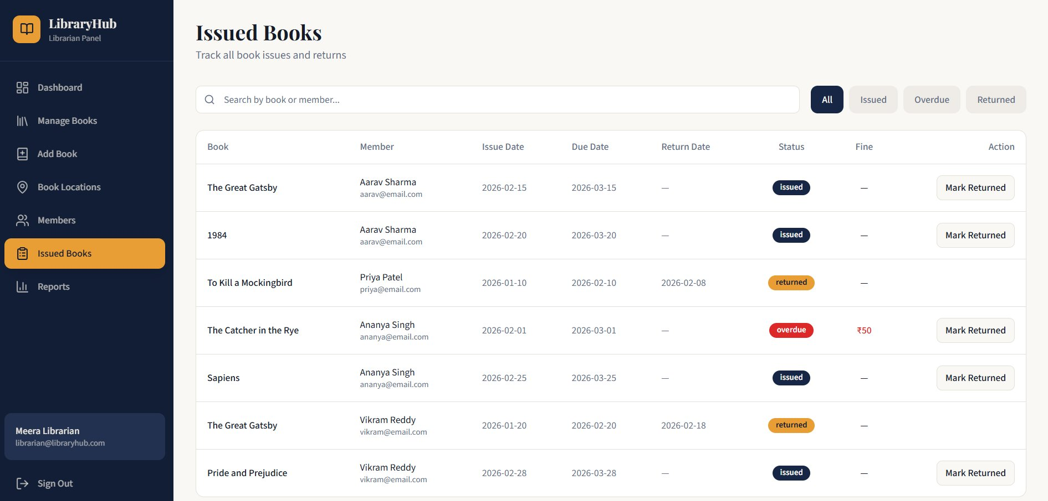
Output 4 — Issued Books (Borrow Tracking)
09 / 10
✅ issued / returned / overdue
⚠️ Overdue fine ₹50 shown
↩ Mark Returned action
📅 Issue, Due & Return dates

Slide 25
TEAM MEMBER
Member 4 — Borrow Request & Approval Service
HK
D. Humera Kausar
Roll No: 239Y1A0549
B.Tech Computer Science | Borrow Service Owner
MY RESPONSIBILITIES
Entity Design
Repository Layer
Service Logic
BorrowRecord.java — id, studentId, bookId, dates, status enum
findByStudentId(), findByStatus(), findByBookId()
requestBorrow(), approveBorrow(), rejectBorrow() with guards
REST API Endpoints
Frontend Integration
Security Guards
POST, GET, PUT — full CRUD for borrow workflow
BrowseBooks.tsx, MyBooks.tsx, LibrarianDashboard.tsx
If-conditions block double-approvals & invalid states

Slide 26
PROJECT OVERVIEW
What is LibraryHub?
Technology Stack
Full-stack Library Management System
Frontend
React + TypeScript + Tailwind CSS
Built with Spring Boot microservices
Backend
Spring Boot 4.x + Java 25
React + TypeScript frontend
Database
MySQL 9.6 + Hibernate ORM
MySQL database with Hibernate ORM
API
RESTful APIs + Axios
Role-based: Student, Librarian, Admin
Tools
STS, VS Code, Postman, MySQL Workbench
Real-time borrow request workflow
Build
Maven + Vite
Built as a collaborative microservice architecture — each team member owns one service end-to-end

Slide 27
BORROW REQUEST WORKFLOW
① Student
Clicks 'Request to Borrow'
② POST Request
/api/borrow-requests
③ MySQL Saves
status = "REQUESTED"
▶
▶
▼
⑥ Student Checks
My Books → sees live status
⑤ PUT Decision
?status=APPROVED / REJECTED
④ Librarian Views
GET /borrow-requests
◀
▼
◀
✅ APPROVED
❌ REJECTED
status update
🔒 Security Guard: Service checks status === REQUESTED before allowing approve/reject — prevents double-processing

Slide 28
REST API ENDPOINTS
POST
/api/borrow-requests
Student
Student submits a new borrow request for a book
GET
/api/librarian/borrow-requests
Librarian
Librarian fetches all records with status REQUESTED
PUT
/api/librarian/borrow-request/{id}?status=APPROVED
Librarian
Librarian approves the borrow request — status → APPROVED
PUT
/api/librarian/borrow-request/{id}?status=REJECTED
Librarian
Librarian rejects the borrow request — status → REJECTED
GET
/api/borrow-requests/student/{studentId}
Student
Student views their own borrow history and status

Slide 29
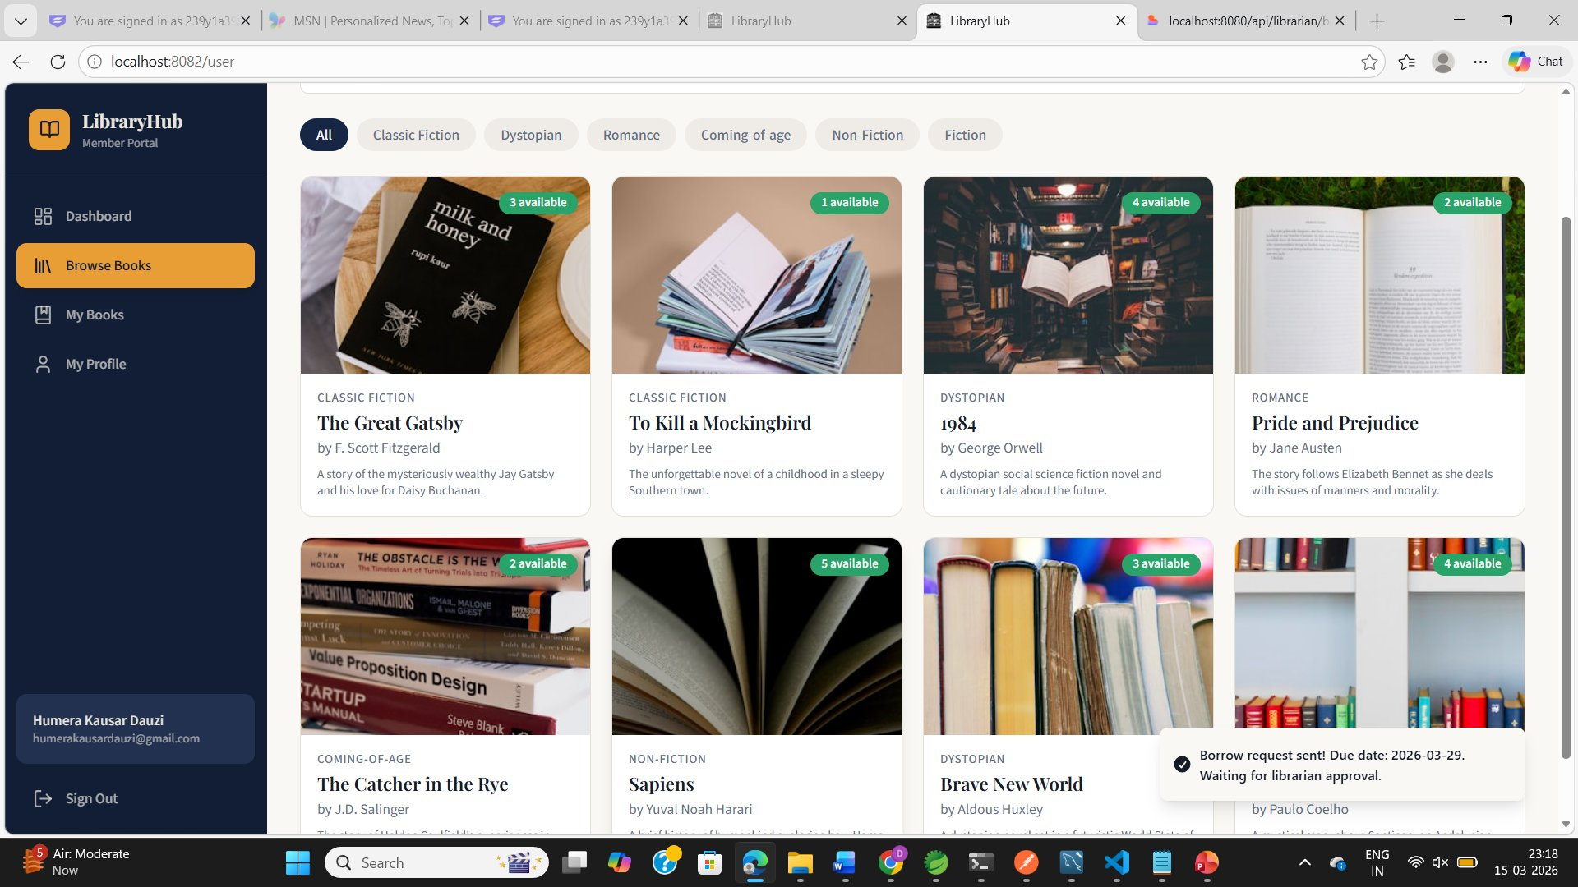
OUTPUT 1 — Student: Browse Books & Send Request
Logged in as
Humera Kausar Dauzi
humerakausardauzi@gmail.com
Toast notification shown:
"Borrow request sent!"
Due: 2026-03-29
What happened:
POST /api/borrow-requests
Record saved in MySQL
status = "REQUESTED"

Slide 30
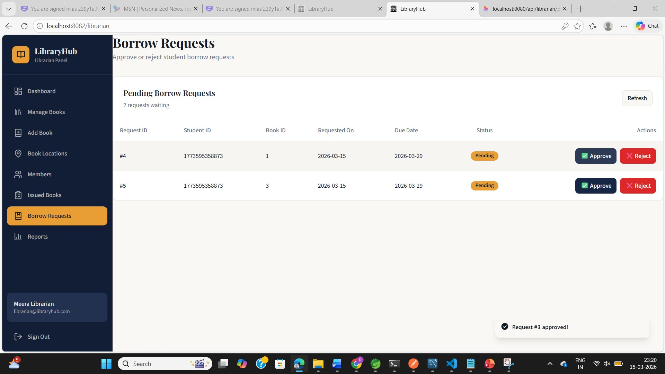
OUTPUT 2 — Librarian: View Pending & Approve Requests
Logged in as
Meera Librarian
librarian@libraryhub.com
2 requests pending
Request #3 already approved
(toast visible)
'Request #3 approved! ✓'
What happened:
GET /librarian/borrow-requests
Shows IDs #4 and #5 pending
PUT ?status=APPROVED fires
MySQL updates instantly

Slide 31
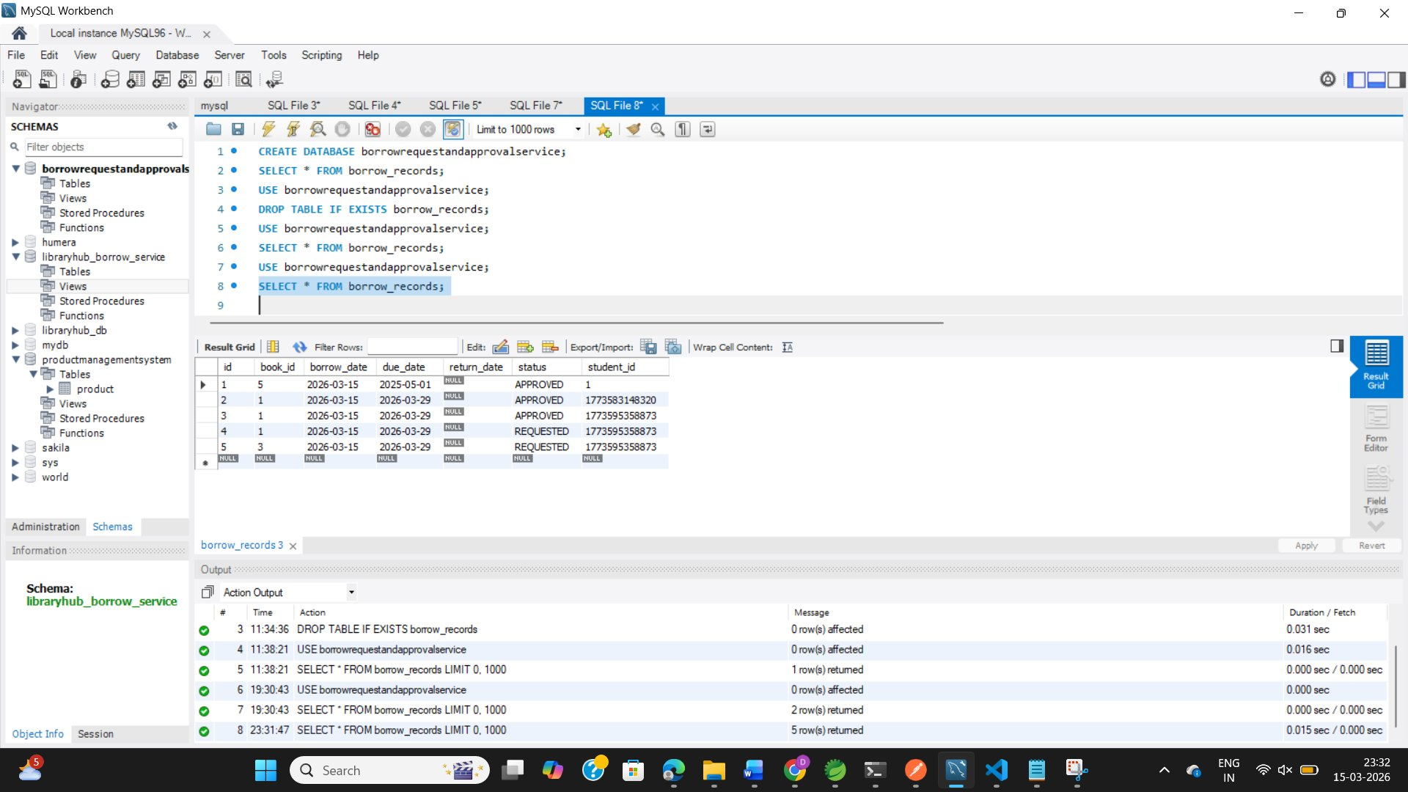
OUTPUT 3 — MySQL Database Confirmation
5
Total Records
3
APPROVED
2
REQUESTED (pending)
100%
Data persisted
SELECT * FROM borrow_records — 5 rows returned, all data persisted correctly in MySQL

Slide 32
CONCLUSION
Member 4 — Fully Delivered
D. Humera Kausar | Roll No: 239Y1A0549
Backend: Spring Boot | Database: MySQL | Frontend: React
Backend: Spring Boot | Database: MySQL | rontend: React
🏗️
🎨
🔒
✅
Backend
Frontend
Security
Tested
Spring Boot REST API
JPA + MySQL + Hibernate
React + TypeScript
BrowseBooks · MyBooks · Dashboard
If-condition guards
Prevent invalid state changes
Postman · Browser
MySQL Workbench verified
Thank You • LibraryHub — Library Management System • 2025–26

Slide 33
LibraryHub — Library Management System
Member 5
Student Borrowing &
History Service
Backend: Spring Boot | Database: MySQL | Frontend: React
FR-02 • FR-04
Microservice Project • Group of 10 Members

Slide 34
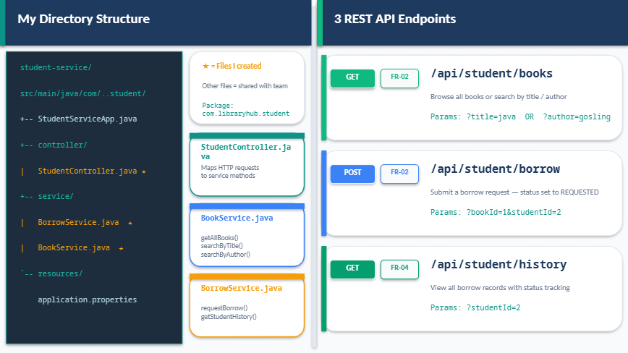

Slide 35
How the Student Flow Works
1
Student Logs In
JWT token issued by Auth Service — Member 1
2
Browse Books
GET /api/student/books — fetches from MySQL books table
3
Submit Borrow Request
POST /api/student/borrow — creates borrow_record (REQUESTED)
4
Librarian Approves
Member 4 changes status REQUESTED → APPROVED
5
Return Book
Member 6 changes status APPROVED → RETURNED
6
View History
GET /api/student/history — shows all records with status

Slide 36
How I Connected with Other Members
Build Order: Member 1 (Auth) → Members 2, 3 → Members 4, 5, 6, 7 → Members 8, 9, 10
Member 1 — Auth Service
Depends On
Member 2 — Book Catalog
Depends On
• Uses JWT token from Member 1 to authenticate student requests
• Book.java entity owned by Member 2 — I just use it
• @PreAuthorize('hasRole(STUDENT)') guards all my endpoints
• BookRepository.java created by Member 2 — I import it
• Same JWT secret key used in JwtUtil.java
• My BookService calls findAll(), findByTitle(), findByAuthor()
• Student must login via Member 1 before using my APIs
• Both librarian and student share same books table
Member 4 — Borrow Approval
Depends On
Member 10 — Student Frontend UI
Used By
• BorrowRecord.java entity owned by Member 4 — I use it
• StudentBooksPage.jsx calls my GET /api/student/books
• BorrowRecordRepository.java created by Member 4
• BorrowHistoryPage.jsx calls my GET /api/student/history
• I create records with status REQUESTED
• Borrow button calls my POST /api/student/borrow
• Member 4 then changes status to APPROVED or REJECTED
• Member 8's HttpService.js attaches JWT to all my API calls

Slide 37
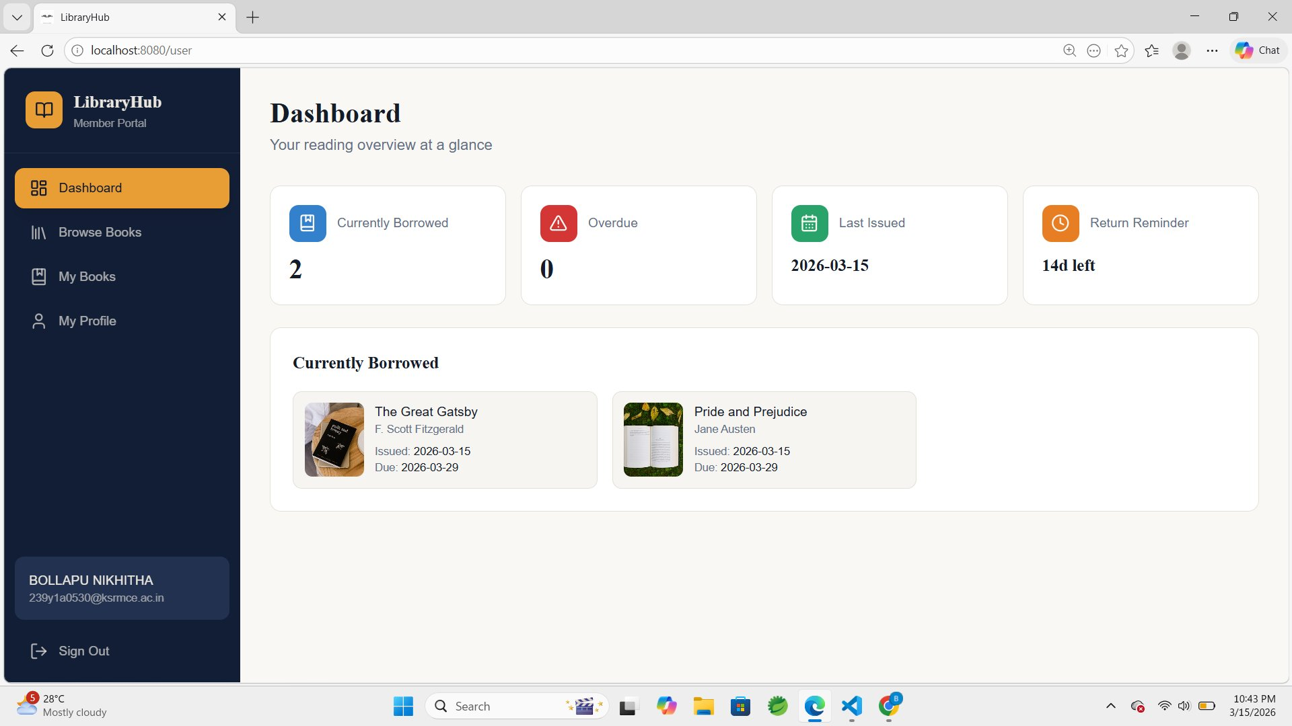
Output — Student Dashboard
Live Application ✓
Dashboard Stats
Currently Borrowed: 2
Overdue: 0
Last Issued: 2026-03-15
Return Reminder: 14d left
Shows currently borrowed
books with issue & due dates
Logged in as: BOLLAPU NIKHITHA

Slide 38
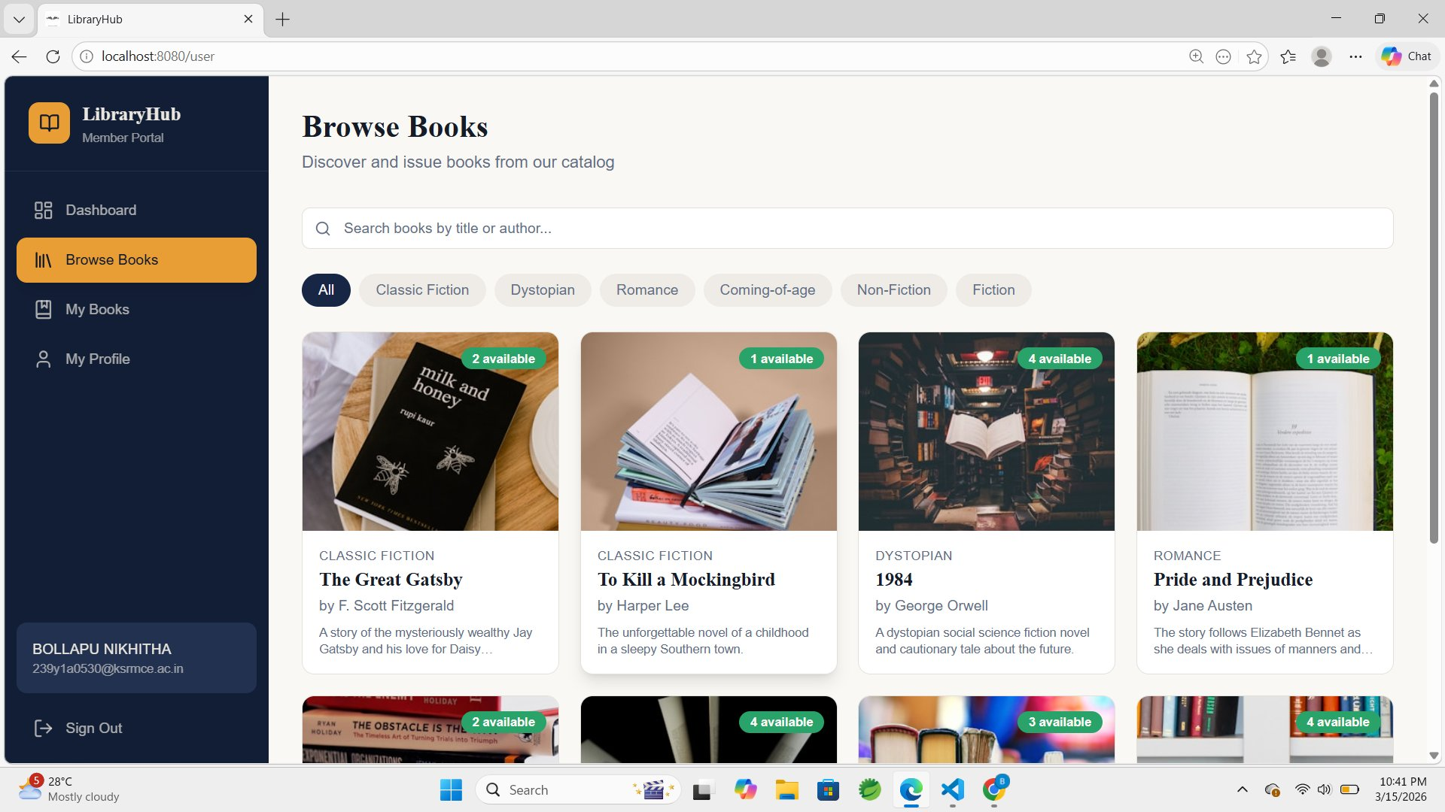
Output — Browse Books (FR-02)
GET /api/student/books
What this shows
Books loaded from
MySQL database
Search bar — title
or author filter
Genre filter pills
(All, Fiction, etc)
Available copies
badge on each card
Click card to view
details & borrow

Slide 39
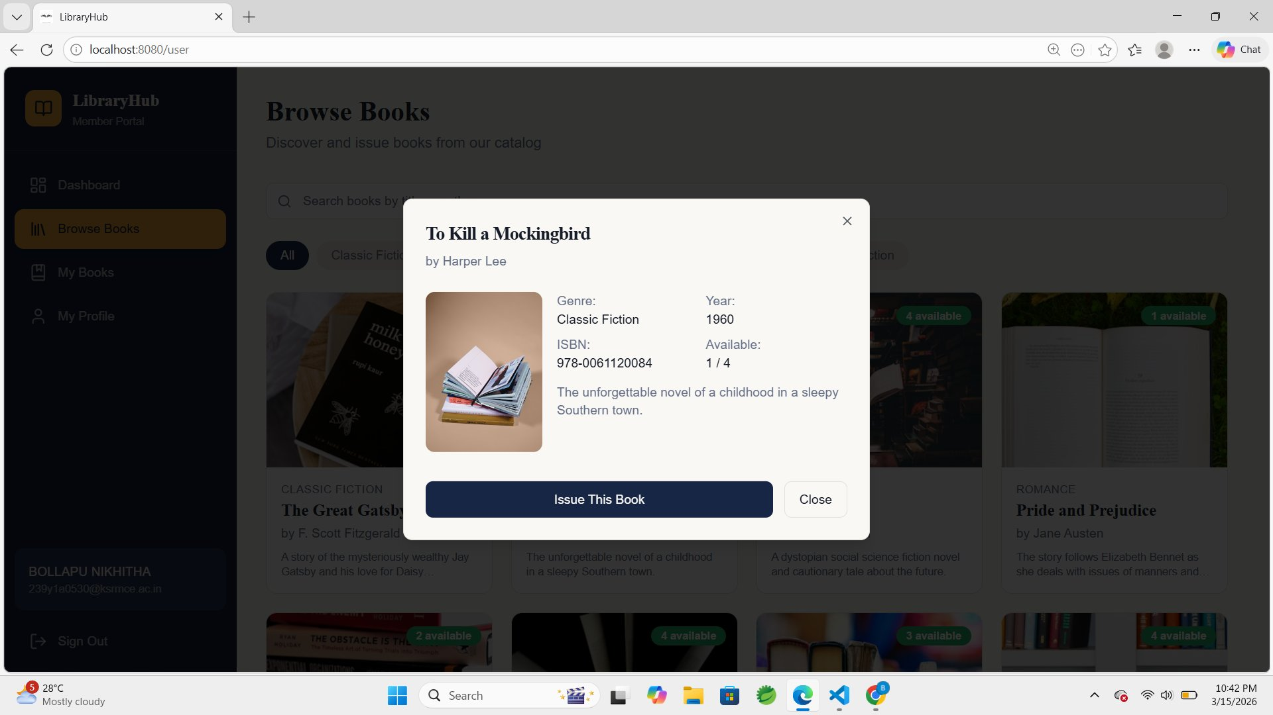
Output — Book Details & Issue (FR-02)
POST /api/student/borrow
Borrow Flow
1
Student clicks
on a book card
2
Modal shows book
details & copies
3
Student clicks
'Issue This Book'
4
POST /borrow called
with bookId
5
Status saved as
REQUESTED in DB

Slide 40
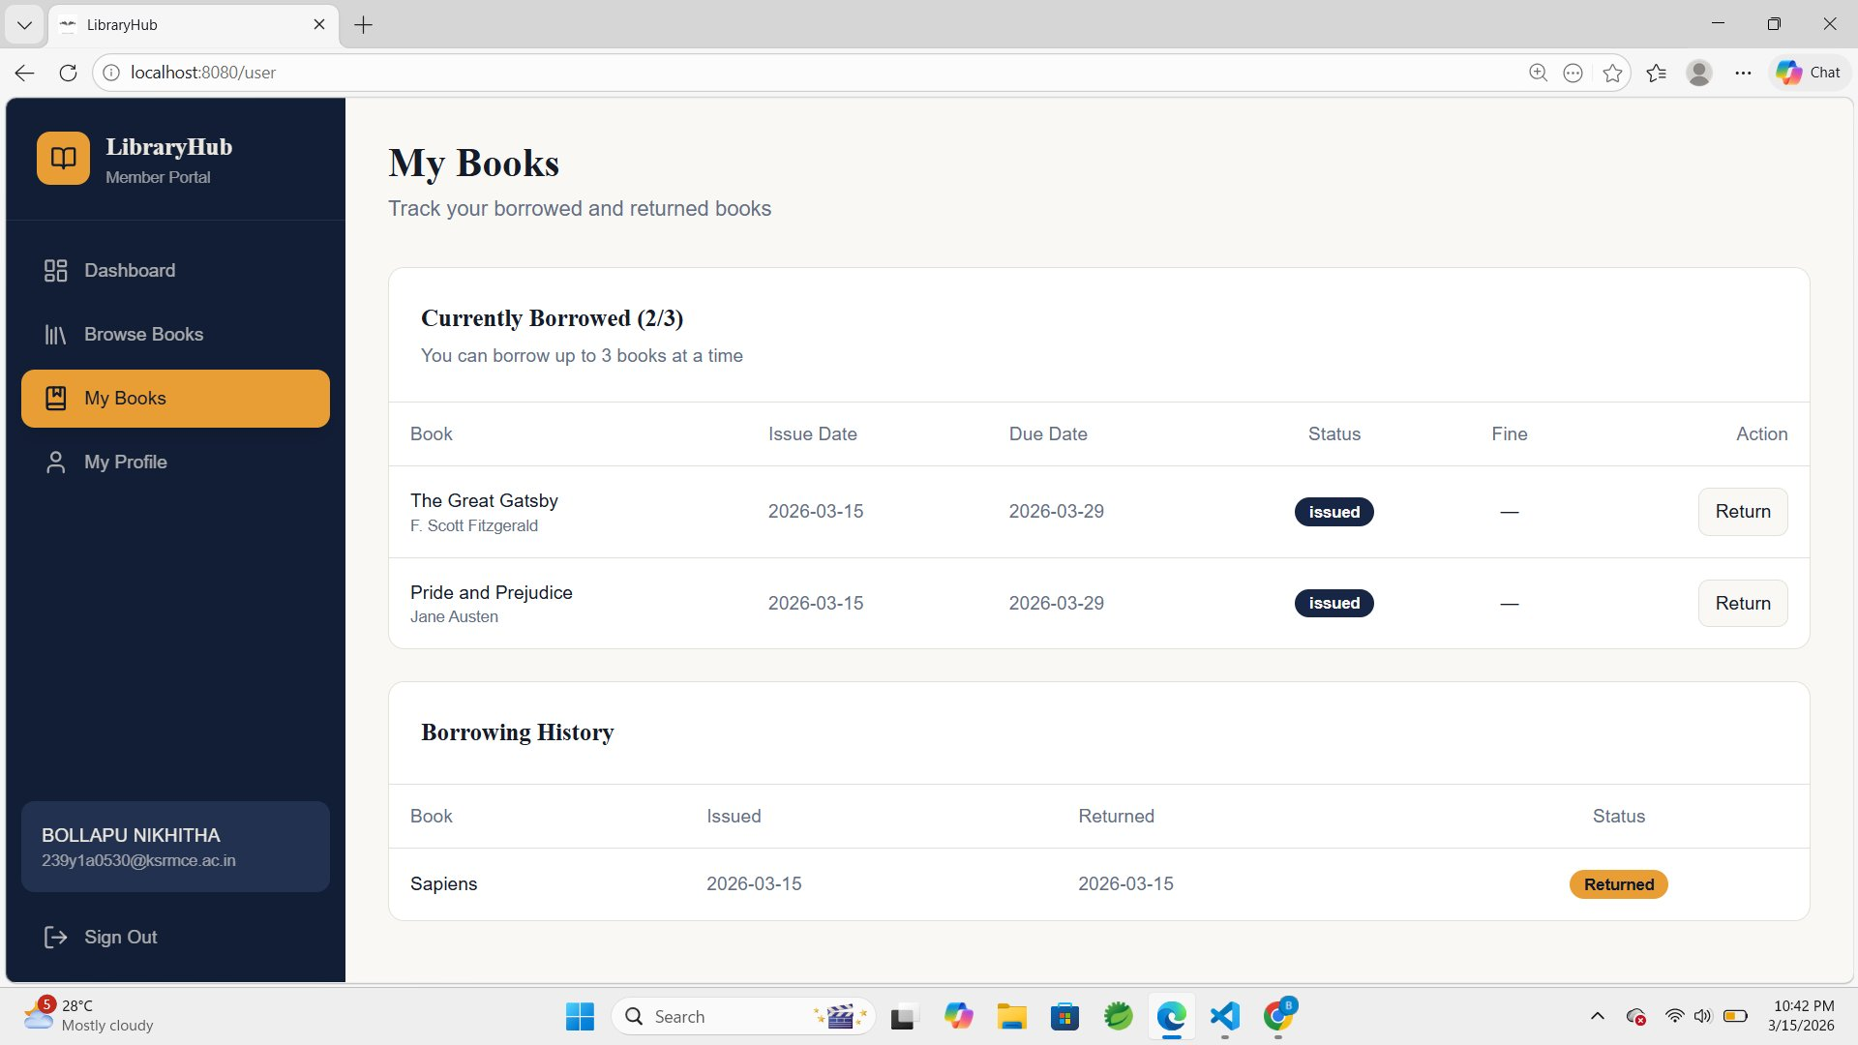
Output — My Books & Borrow History (FR-04)
GET /api/student/history
What this shows
Currently Borrowed
2/3 books borrowed
Status: issued
The Great Gatsby
Pride and Prejudice
Status: Returned
Sapiens — returned
2026-03-15
Borrow History
Full history table
with status badges
Return Action
Return button per
borrowed book

Slide 41
Return &&
Inventory
Management
Management
🔄
M E M B E R 6
LibraryHub — Case Study 07
Service
Microservice Assignment
Group of 7 Members
D. Gurulakshmi
Spring Boot · MySQL · React
FR-03 · BorrowService.java · LIBRARIAN Role Only

Slide 42
Service Overview
Member 6 owns the Return & Inventory Service — the back-end service that handles book returns and keeps the library inventory accurate by incrementing availableCopies on every successful return.
🔄
📦
🔒
Record Return
Update Inventory
LIBRARIAN Only
Librarian records a book return by entering Book ID and User ID via the React UI
availableCopies is incremented by 1 on every successful return — inventory stays accurate
Endpoint is restricted to LIBRARIAN role only — students cannot record returns
LibraryHub · Member 6 — Return & Inventory Management Service

Slide 43
REST API Endpoint
POST
/return/{bookId}/{userId}
LIBRARIAN only
Method
POST
URL
/return/{bookId}/{userId}
Role
LIBRARIAN
Action
Calls returnBook(bookId, userId) in BorrowService
Response
Book returned successfully for User Id:{userId}
On Error
RuntimeException — Book not found with id: {bookId}
LibraryHub · Member 6 — Return & Inventory Management Service

Slide 44
Directory Structure
return-service / src / main / java / com / libraryhub / rs
Key Files
return-service/
src/main/java/com/libraryhub/rs/
+-- ReturnServiceApplication.java
+-- controller/
| ReturnController.java
+-- entity/
| Book.java
+-- repository/
| BookRepository.java
+-- service/
| BorrowService.java
+-- resources/
application.properties
ReturnServiceApplication.java
Spring Boot entry point for the return microservice
ReturnController.java
POST /return/{bookId}/{userId} — REST endpoint
BorrowService.java
returnBook() + incrementAvailableCopies() logic
application.properties
DB connection, server port 8085, MySQL config
LibraryHub · Member 6 — Return & Inventory Management Service

Slide 45
Deliverables
1
⚙️
ReturnController.java
REST controller — POST /return/{bookId}/{userId} wired to BorrowService
2
💻
returnBook()
Calls incrementAvailableCopies() and returns success message to frontend
3
📦
incrementAvailableCopies()
Loads book from DB, adds 1 to availableCopies, saves back to MySQL
4
📋
Book.java + BookRepository.java
Entity and repository from C. Mythili (Member 2) — used in BorrowService
5
🔒
@CrossOrigin + CORS config
Allows React (port 8080) to call Spring Boot (port 8085) without CORS errors
LibraryHub · Member 6 — Return & Inventory Management Service

Slide 46
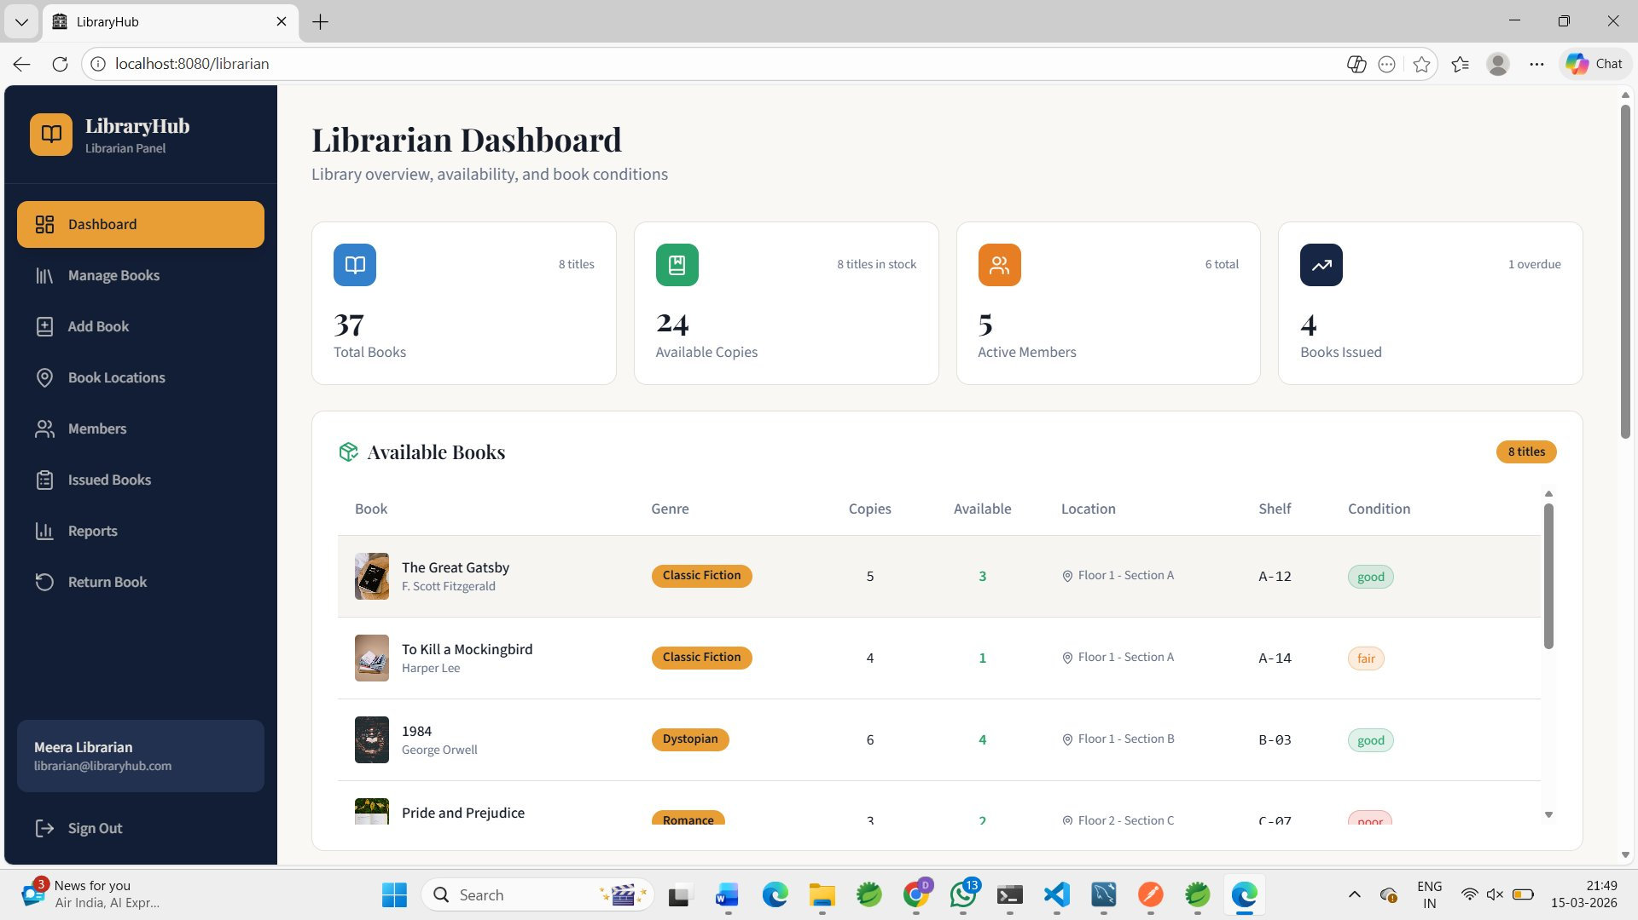
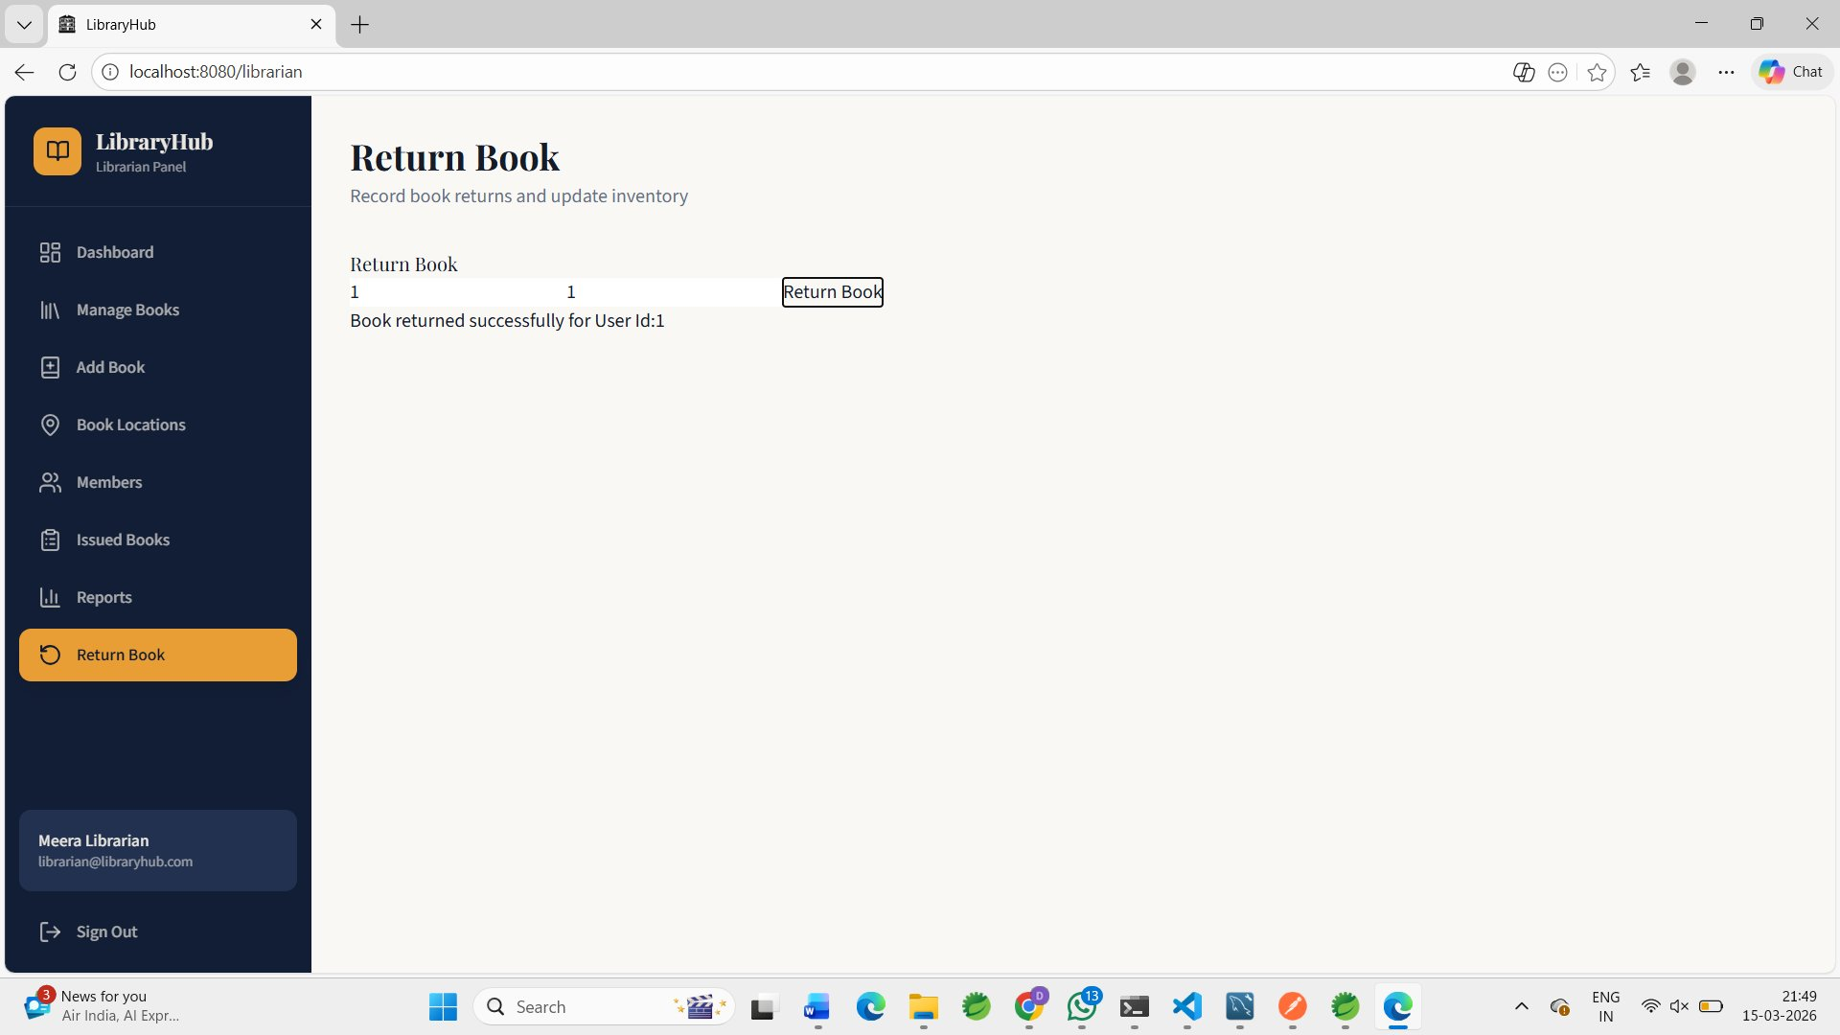
Project Output — Live Demo Screenshots
Librarian Dashboard
Return Book — Success Output
Return Book tab visible in sidebar ✔
Book returned successfully for User Id:1 ✔
LibraryHub · Member 6 — Return & Inventory Management Service

Slide 47

Admin User
Management
MEMBER 7
Service
LibraryHub — Case Study 07
Microservice Assignment
Spring Boot · Spring Security · MySQL · React
Group of 10 Members
FR-05 · AdminController.java · ADMIN Role Only

Slide 48



Service Overview
Member 7 owns the Admin Portal — the back-end service that gives the ADMIN role complete control over user accounts and system-wide activity reporting across the entire LibraryHub platform.
View All Users
Remove Accounts
System Reports
Retrieve every registered user with their assigned role (ADMIN / LIBRARIAN / STUDENT).
Deactivate or permanently delete any user account from the system.
Access a consolidated summary of all borrow and return activity across the library.
LibraryHub · Member 7 — Admin User Management Service

Slide 49
Directory Structure
admin-service / src / main / java / com / libraryhub / admin
Key Files
admin-service/
AdminServiceApplication.java
src/main/java/com/libraryhub/admin/
Spring Boot entry point for the admin microservice
+-- AdminServiceApplication.java
+-- controller/
AdminController.java
| AdminController.java
Defines GET /users, DELETE /users/{id}, GET /reports
+-- service/
AdminService.java
| AdminService.java
Business logic: user retrieval, deletion, report aggregation
+-- resources/
| application.properties
application.properties
DB connection, server port, and JWT configuration
LibraryHub · Member 7 — Admin User Management Service

Slide 50
REST API Endpoints
/api/admin/users
ADMIN only
GET
Returns all registered users with id, username, email, and role.
/api/admin/users/{id}
ADMIN only
DELETE
Deactivates or permanently removes the specified user account.
/api/admin/reports
ADMIN only
GET
Returns a system-wide summary of all borrow and return activity.
All three endpoints are restricted to the ADMIN role via Spring Security role guards — no librarian or student access permitted.
LibraryHub · Member 7 — Admin User Management Service

Slide 51
Build Order & Dependencies
1
2–3
4–6
7
›
›
›
Member 1
Auth Service
Members 2–3
Catalog/Books
Members 4–6
Borrow/Return
Member 7
Admin Service
JWT + Security
Book entities
BorrowRecord
YOU ARE HERE
Member 7 depends on:
Member 1 (Auth Service)
— JWT security config — all admin endpoints must validate an ADMIN role token.
Members 2–3 (Catalog Service)
— User and Book data — reports reference both entities.
Members 4–6 (Borrow / Return)
— BorrowRecord data — admin report summarises borrow and return activity.
LibraryHub · Member 7 — Admin User Management Service

Slide 52
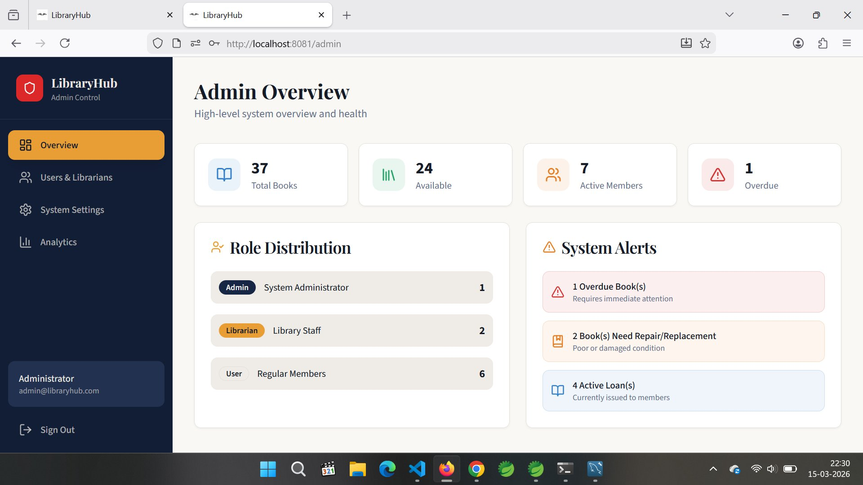
Output — Admin Overview Dashboard
http://localhost:8081/admin · Spring Boot (8080) + React (8081) + MySQL connected
LibraryHub · Member 7 — Admin User Management Service

Slide 53
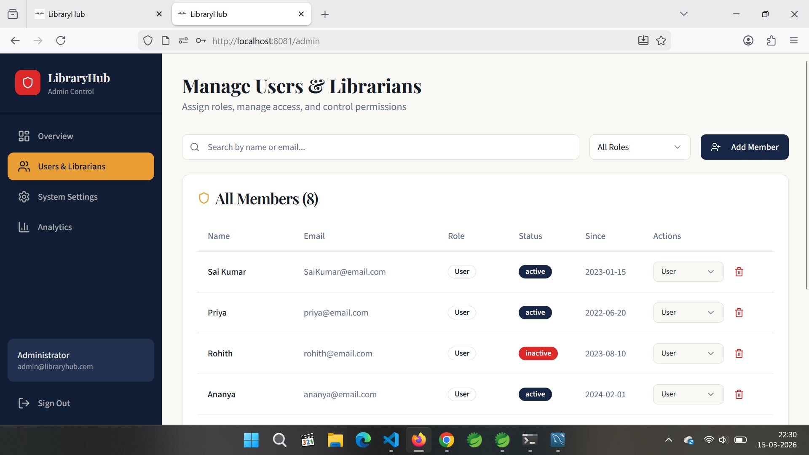
Output — Manage Users & Librarians
8 Members listed · Role management + Delete actions · React frontend connected to Spring Boot
LibraryHub · Member 7 — Admin User Management Service

Slide 54
